Slide 1

SDP 305: Robotic Arm
For NES Power Glove
Maxine Krueger, Nicholas Marzan, John Milham, Ragul Ganesh Anitha Palanivel
Faculty Advisor: Dr. Jaeho Lee
5/2/2025

Slide 2
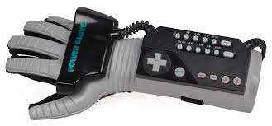
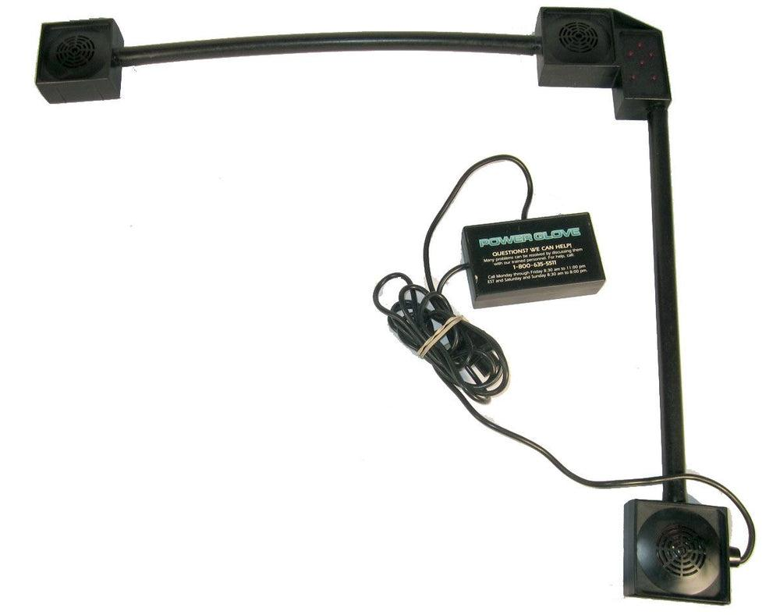
What is the NES Power Glove?
2-bit sensor per finger (minus the pinky)
Transmits signal to motion sensor
Turns inputs from hand movement to controller inputs
Notes:
Nick

Slide 3
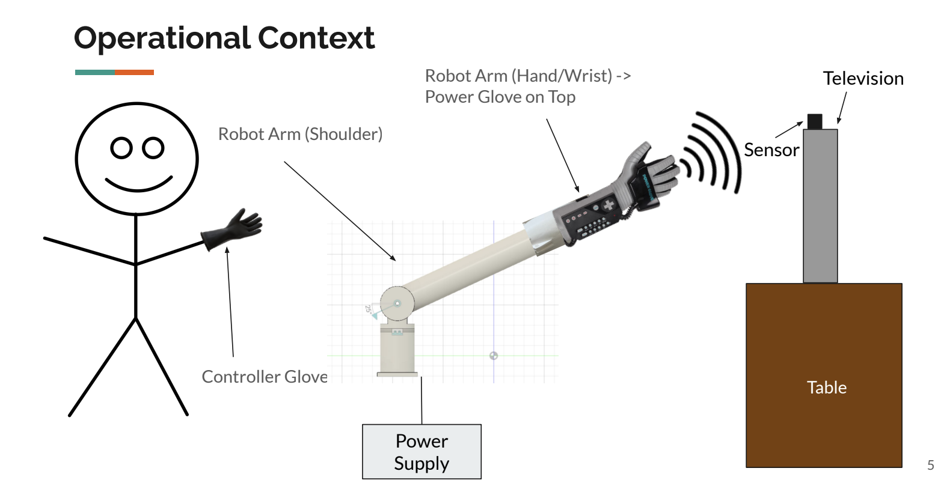
Project Concept
Notes:
Ragul

Slide 4
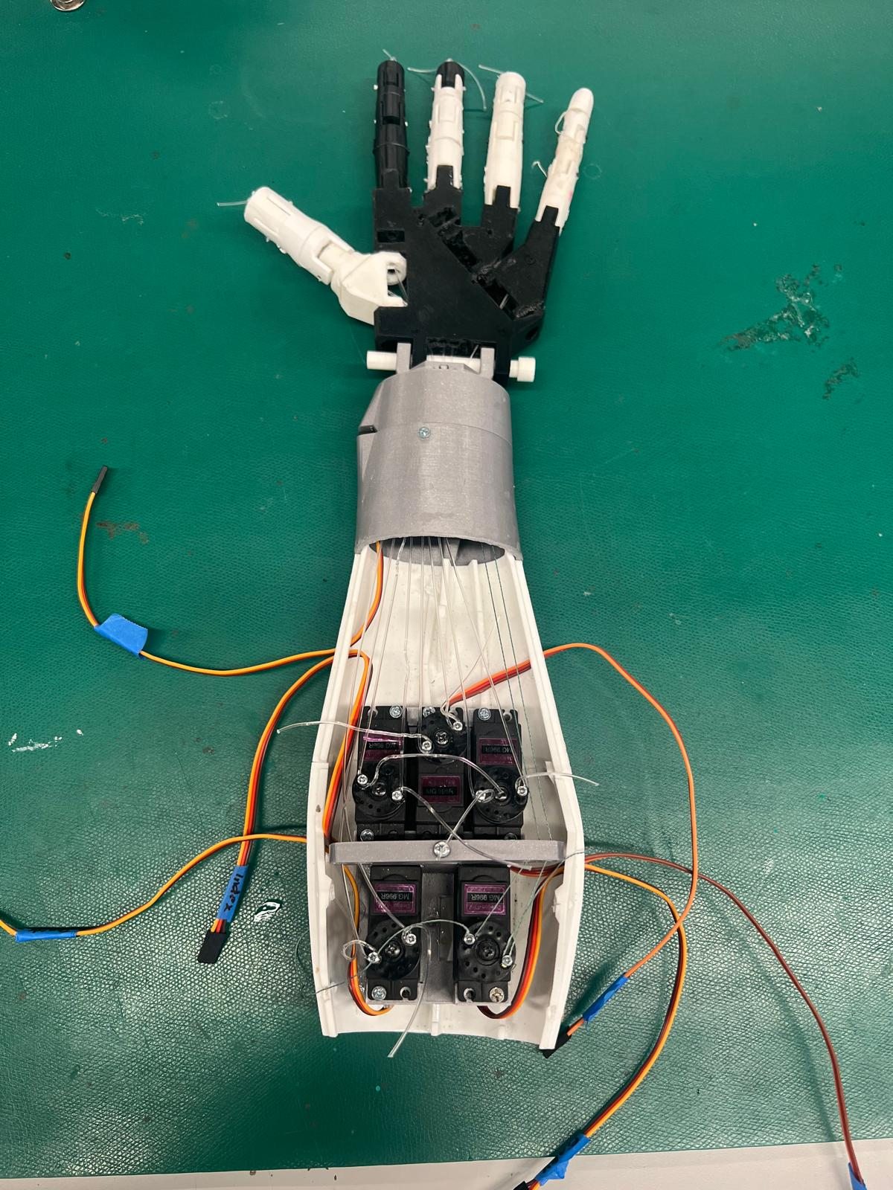
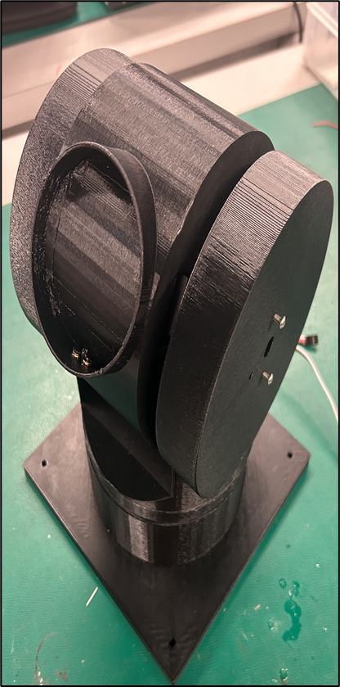
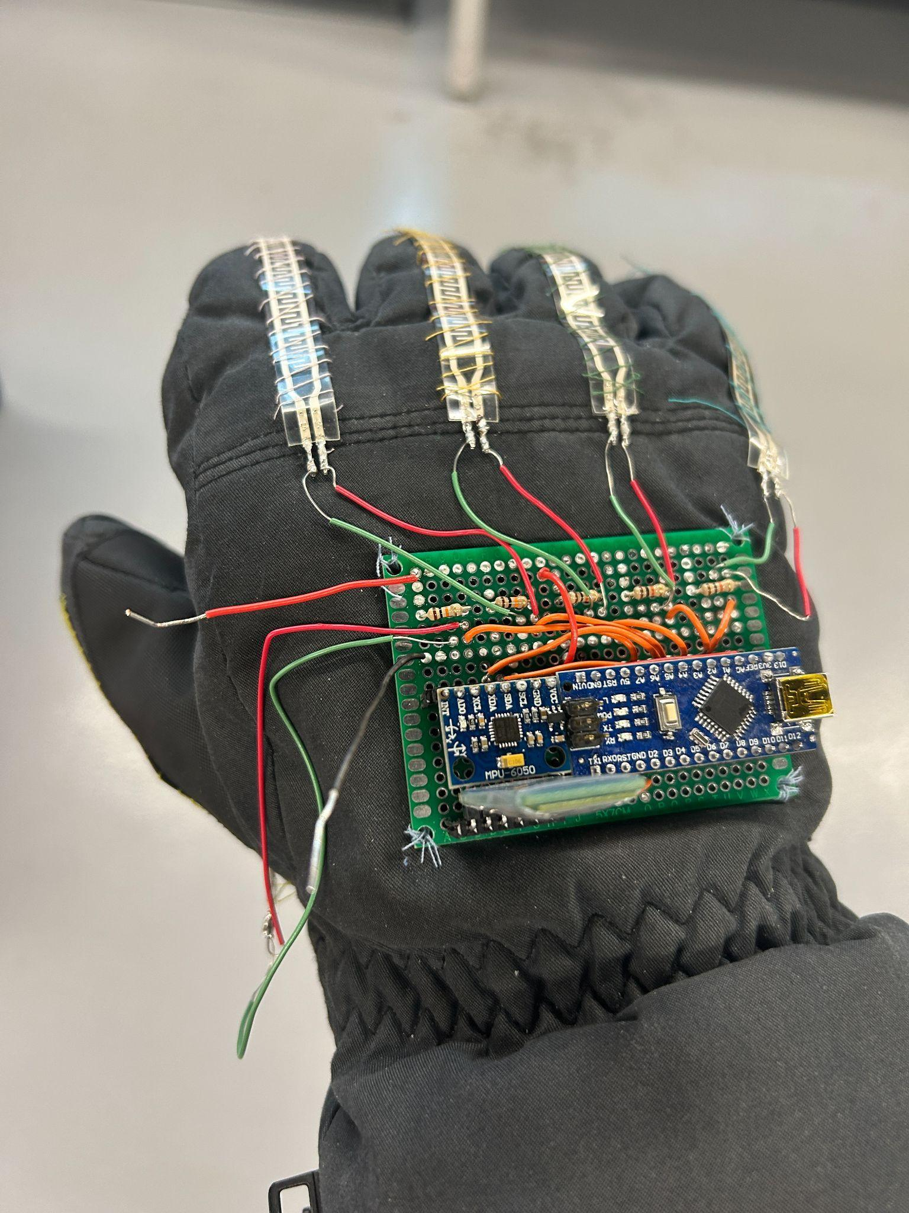
Last Years Design - ECD 416
Notes:
Ragul

Slide 5
Project Requirements and Specifications
Requirements:
To fix the issues present in arm and shoulder parts of last years design.
Arm controller is designated to ECE 526.
Specifications:
[MESDP-305-01] The robotic arm fingers shall extend outwards to 180 degrees.
[MESDP-305-02] The robotic arm fingers shall curl 90 degrees to each joint on the finger.
[MESDP-305-03] Wrist mechanism of the arm shall rotate +/- 90 degrees.
[MESDP-305-04] The arm pitch shall be +/- 90 degrees.
[MESDP-305-05] The arm yaw shall be +/- 90 degrees.
[MESDP-305-06] The arm shall fit the NES power glove.
[MESDP-305-07] Movement of the arm shall be uninterrupted.
Notes:
Ragul

Slide 6
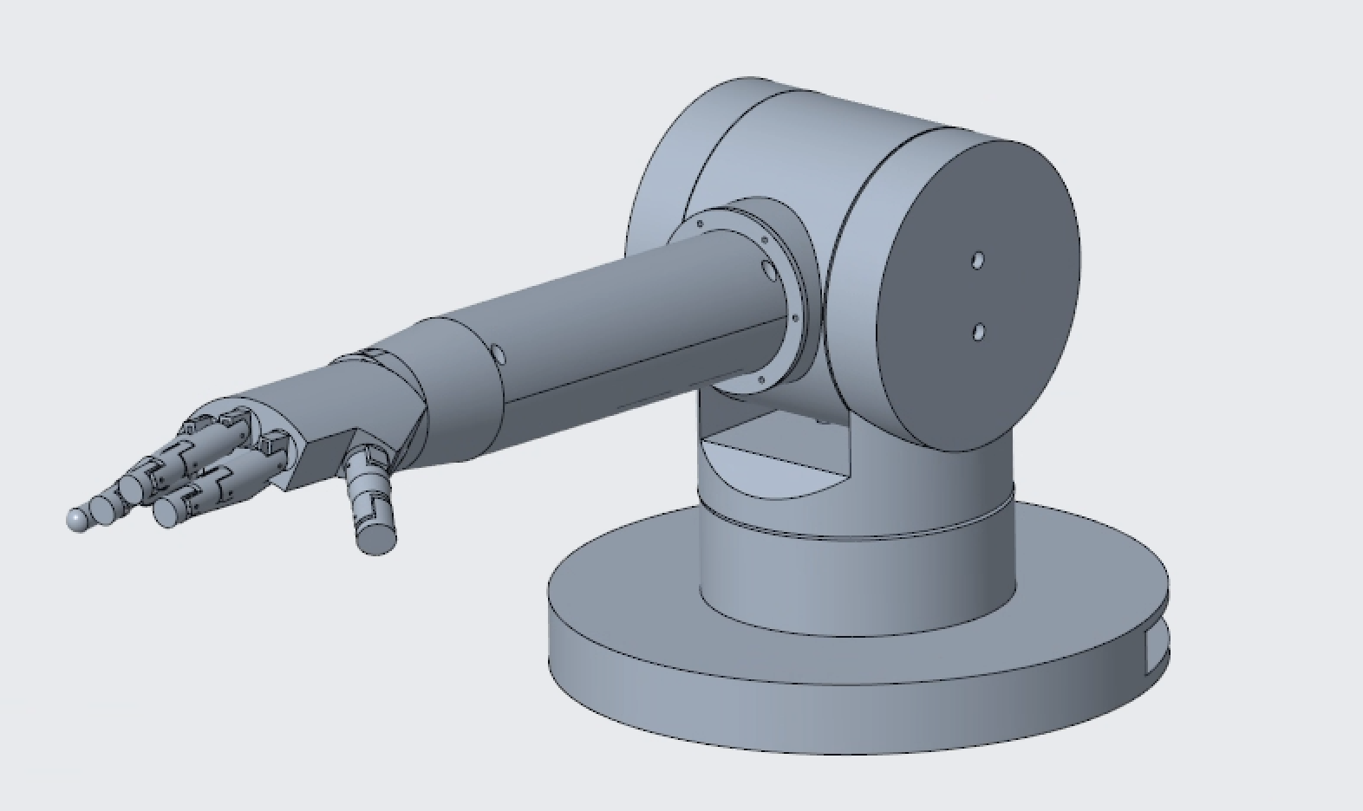
Notes:
Nick

Slide 7
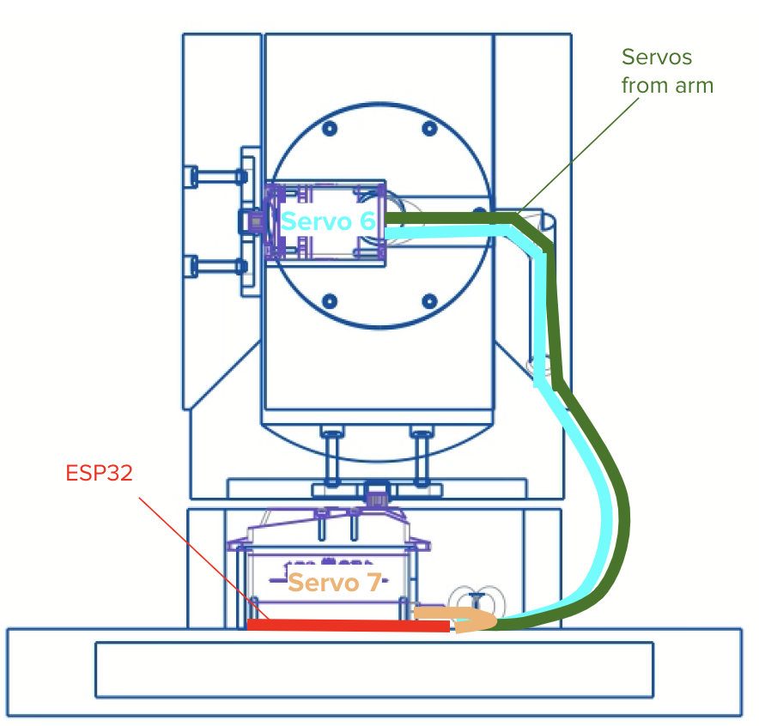
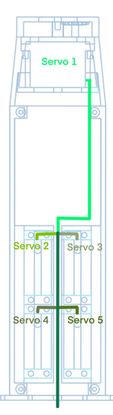
Notes:
Ragul

Slide 8
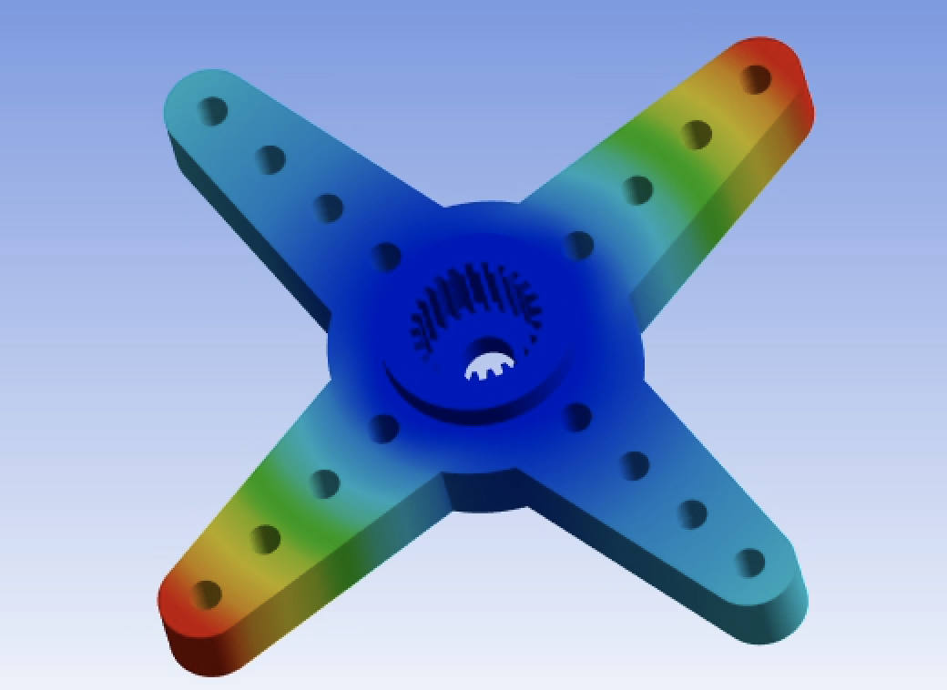
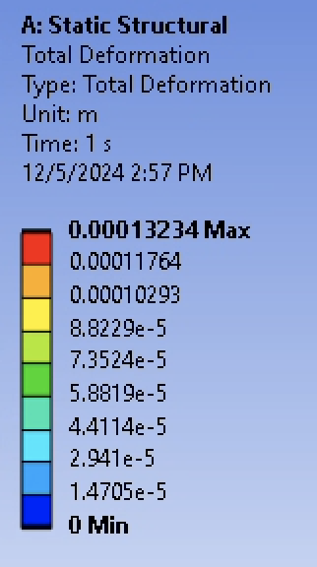
Max deformation =
0.13 mm
Notes:
John

Slide 9
Moving Parts
3 Main Systems

Slide 10
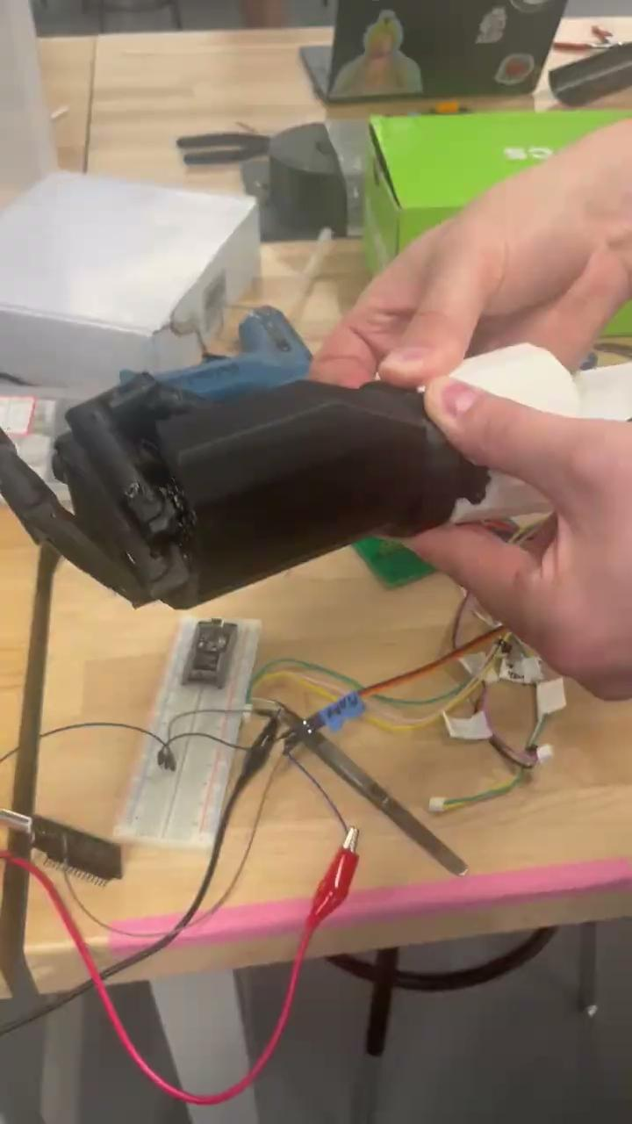
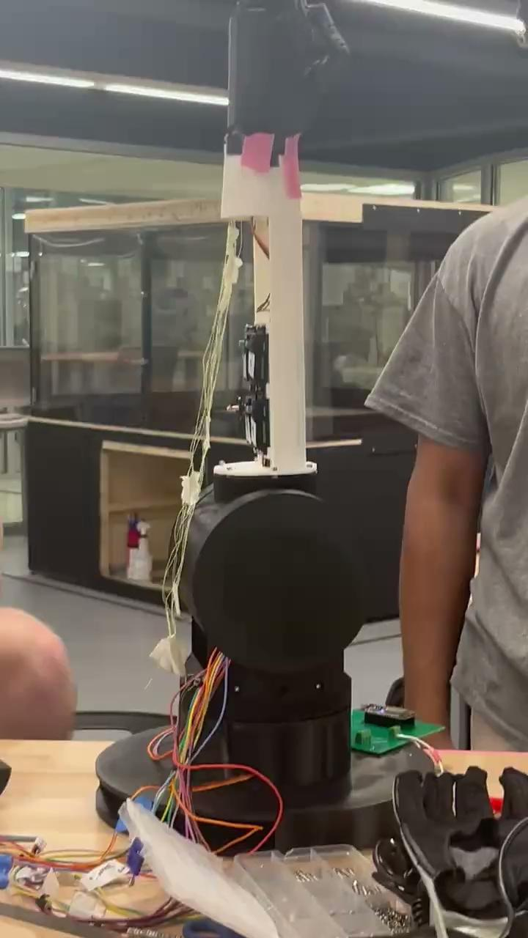
Wrist Rotation
Parts worked separately, issues arose when integrating all moving parts together
Notes:
Ragul

Slide 11
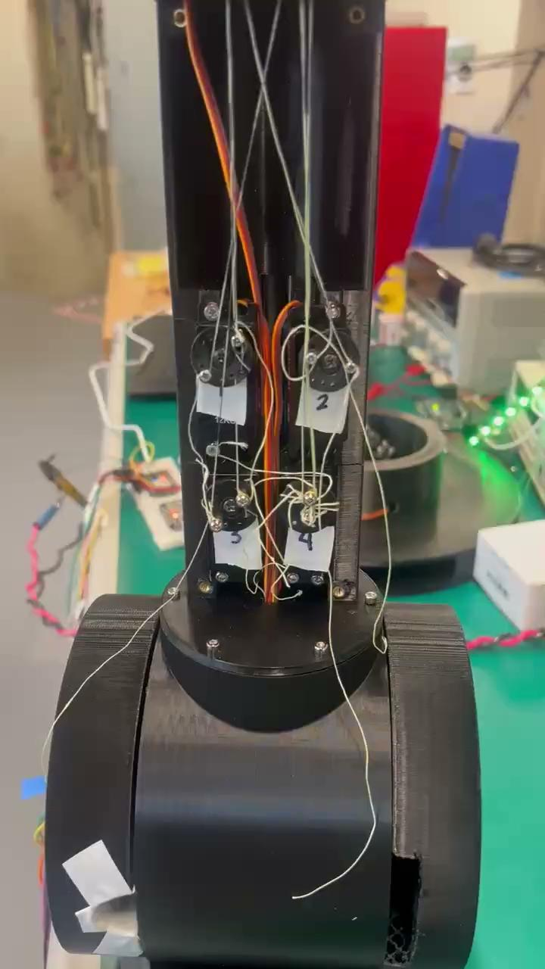
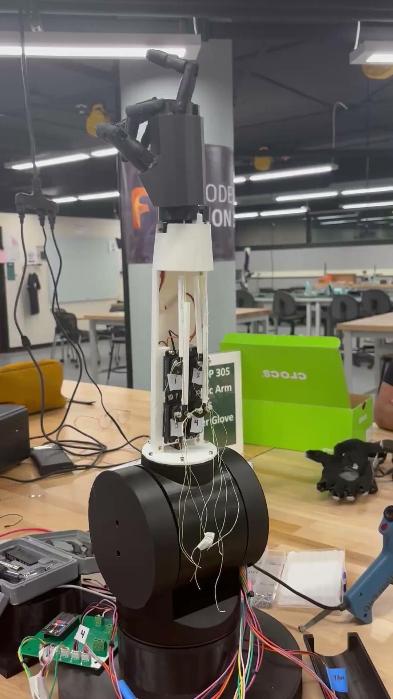
2) Finger Movement
Finger movement currently not fully extending, initial prototyping worked for full finger movement
Notes:
Ragul

Slide 12
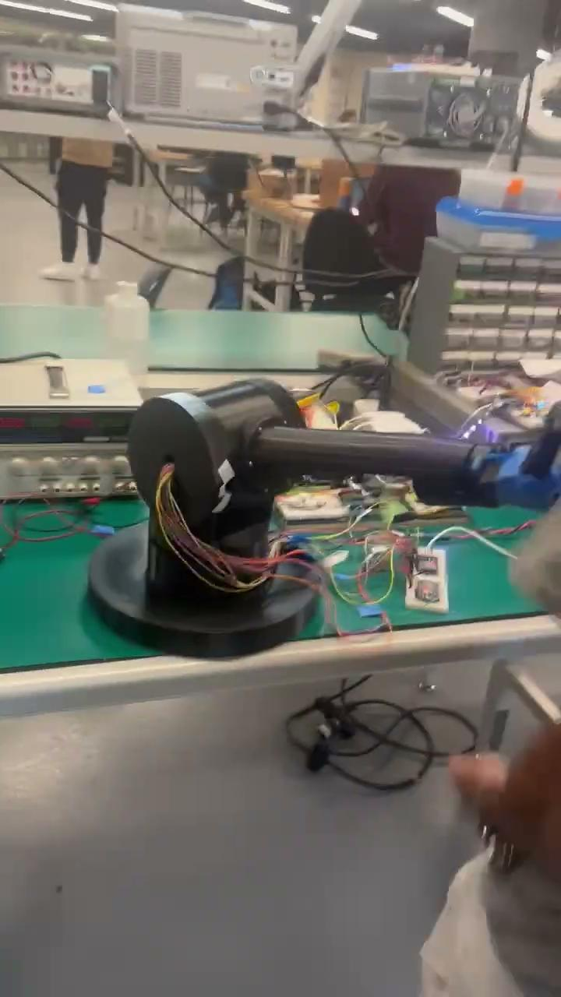
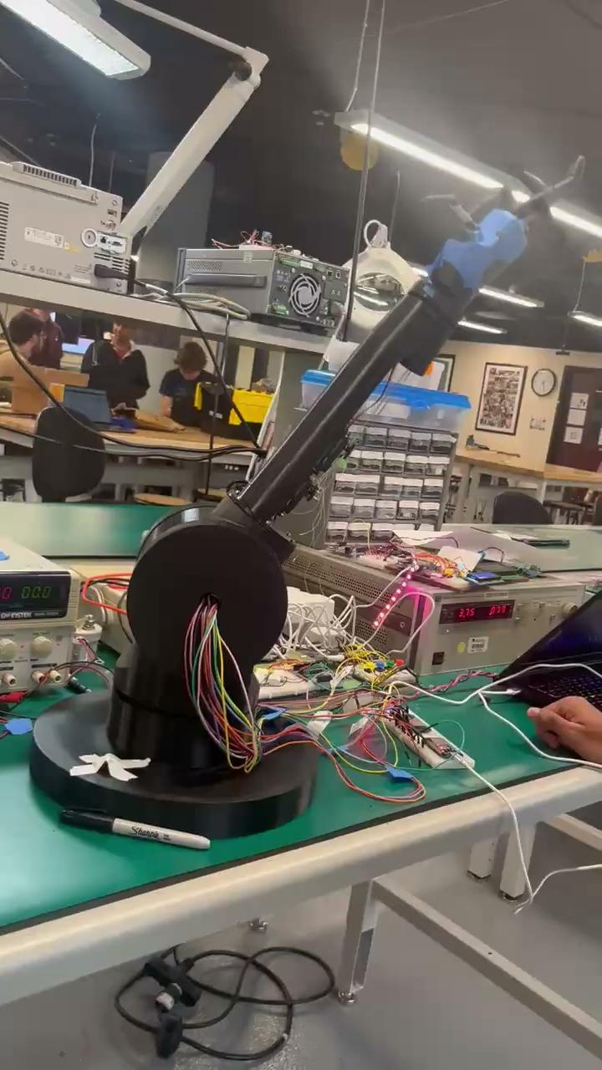
3) Shoulder Movement
Shoulder functional in current iteration, both pitch and yaw
Notes:
Ragul

Slide 13
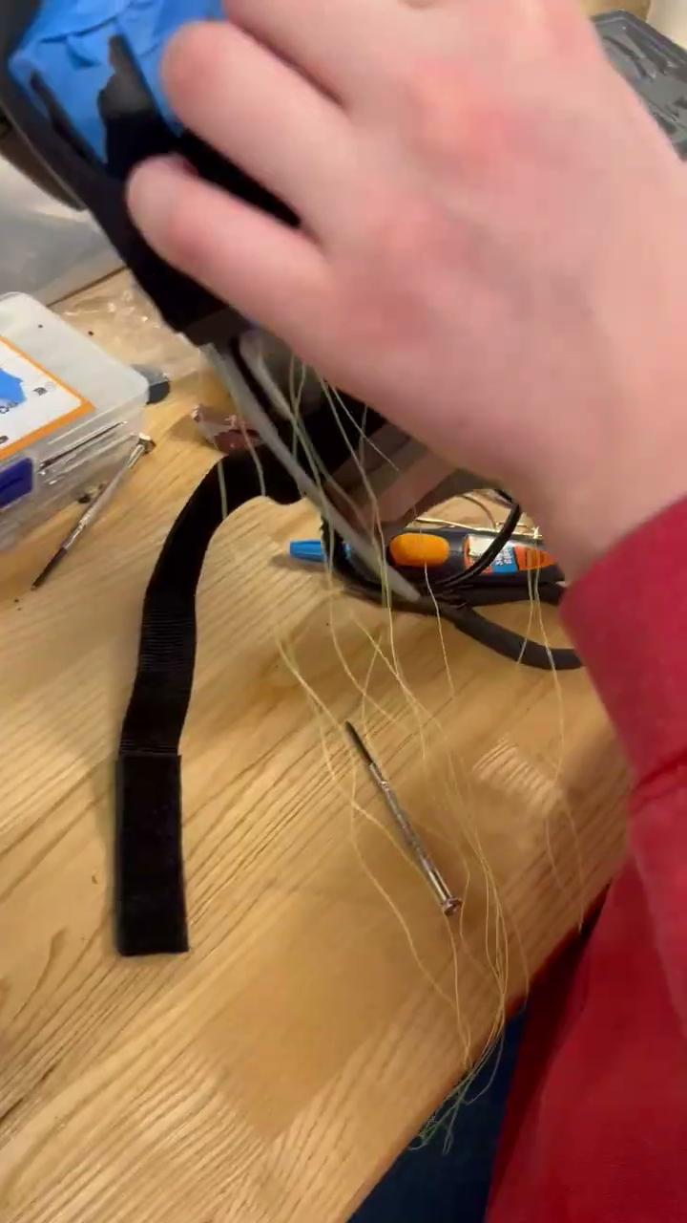
Glove Fitting
The power glove fitting over the hand
Notes:
Ragul

Slide 14

Issues
Wrist and fingers could not operate at the same time, too much tension in the finger lines
Unable to integrate with ECD 526 transmitter glove due to unsuccessful build
Multiple broken parts
Notes:
Ragul

Slide 15

Future Improvements
Move wrist rotation into base of forearm
Continue current finger movement plan, requires finer calibration
Notes:
Ragul

